Slide 1

  Welcome
  Everyone!
  A Legal Prediction Model using
  Support Vector Machine and
  K-means Clustering Algorithm for Predicting
  Judgements and Making Decisions

Slide 2
  Welcome
  Everyone!
  A Legal Prediction Model using
  Support Vector Machine and
  K-means Clustering Algorithm for Predicting
  Judgements and Making Decisions

Slide 3

  A Legal Prediction Model using
  Support Vector Machine and
  K-means Clustering Algorithm for Predicting
  Judgements and Making Decisions
Author/Student:-
Bharathwaj.K.S
Saveetha school of engineering,
Saveetha University
192124033.sse@saveetha.com
Guide:-
Jaya Mabel Rani A
Saveetha school of engineering,
Saveetha University
192124033.sse@saveetha.com

Slide 4

  A Legal Prediction Model using
  Support Vector Machine and
  K-means Clustering Algorithm for Predicting
  Judgements and Making Decisions
Abstract: The legal community's quest for enhanced decision-making tools has led to the development of predictive models that anticipate case outcomes. "Legal Acumen," an innovative machine learning-powered legal prediction model, not only forecasts Indian Supreme Court judgments but also provides valuable insights into the relevant laws. This presentation introduces "Legal Acumen" and its capabilities, including rapid analysis of new case descriptions for predictions and legally informed decisions. "Legal Acumen" is at the forefront of legal prediction models, offering a powerful resource for judges and attorneys seeking to navigate the complexities of Indian Supreme Court decisions.
Keywords: Acumen, prediction, Indian, supreme, court, judgments, decisions, appeals.
Author/Student:-
Bharathwaj.K.S
Saveetha school of engineering,
Saveetha University
192124033.sse@saveetha.com
Guide:-
Jaya Mabel Rani A
Saveetha school of engineering,
Saveetha University
ajayamabelrani@gmail.com

Slide 5
Objective
The legal community's pursuit of improved decision-making tools has spurred the creation of predictive models that can anticipate case outcomes.
"Legal Acumen" is an innovative machine learning-powered legal prediction model designed to forecast Indian Supreme Court judgments and offer insights into the pertinent laws.
This presentation provides an overview of "Legal Acumen" and its capabilities, including the swift analysis of new case descriptions for predictions and legally informed decision-making.
"Legal Acumen" stands as a cutting-edge legal prediction model, serving as a valuable resource for judges and attorneys dealing with the intricacies of Indian Supreme Court decisions.

Slide 6

Introduction
Challenges in the Indian Legal System:
Lengthy Legal Processes: Cases often take over 15 years, straining resources and delaying justice.
The Need for Efficiency: Frustrations and inefficiencies in the system necessitate innovative solutions.
Introducing 'Legal Acumen':
Machine Learning Solution: 'Legal Acumen' is a predictive model for Indian Supreme Court judgments.
SVM for Accuracy: It uses Support Vector Machines (SVM) for highly accurate case outcome predictions.
Informed Decisions: Beyond predictions, it offers legally informed decisions based on case descriptions.
Empowering Legal Professionals:
K-means Clustering: Legal professionals can use this feature to align new cases with legal precedents efficiently.
Closing the Gap:
Bridging Complexity and Efficiency: 'Legal Acumen' aims to make the Indian legal system more efficient and accessible for all.

Slide 7
Enhancing Legal Decision Analysis:
Goal: Improve legal decision analysis using machine learning techniques.
SVM for Legal Decision Classification:
SVM Application: Use SVM to classify legal decisions based on majority votes and relevant features.
Benefits: SVM's capacity to handle complex decision boundaries makes it ideal for identifying distinct decision types.
K-Means Clustering for Decision Pattern Discovery:
K-Means Usage: Employ K-Means clustering to uncover hidden patterns in legal cases by segmenting based on characteristics like decision types.
Insights: This approach reveals clusters of cases with similar legal attitudes.
Research Contribution:
Combining SVM and K-Means: This research aims to provide innovative tools for effective analysis and interpretation of legal decisions by leveraging SVM for classification and K-Means for pattern discovery.
Introduction
Challenges in the Indian Legal System:
Lengthy Legal Processes: Cases often take over 15 years, straining resources and delaying justice.
The Need for Efficiency: Frustrations and inefficiencies in the system necessitate innovative solutions.
Introducing 'Legal Acumen':
Machine Learning Solution: 'Legal Acumen' is a predictive model for Indian Supreme Court judgments.
SVM for Accuracy: It uses Support Vector Machines (SVM) for highly accurate case outcome predictions.
Informed Decisions: Beyond predictions, it offers legally informed decisions based on case descriptions.
Empowering Legal Professionals:
K-means Clustering: Legal professionals can use this feature to align new cases with legal precedents efficiently.
Closing the Gap:
Bridging Complexity and Efficiency: 'Legal Acumen' aims to make the Indian legal system more efficient and accessible for all.

Slide 8

Proposed work
Enhancing Legal Decision Analysis:
Goal: Improve legal decision analysis using machine learning techniques.
SVM for Legal Decision Classification:
SVM Application: Use SVM to classify legal decisions based on majority votes and relevant features.
Benefits: SVM's capacity to handle complex decision boundaries makes it ideal for identifying distinct decision types.
K-Means Clustering for Decision Pattern Discovery:
K-Means Usage: Employ K-Means clustering to uncover hidden patterns in legal cases by segmenting based on characteristics like decision types.
Insights: This approach reveals clusters of cases with similar legal attitudes.
Research Contribution:
Combining SVM and K-Means: This research aims to provide innovative tools for effective analysis and interpretation of legal decisions by leveraging SVM for classification and K-Means for pattern discovery.

Slide 9

Architecture

Slide 10
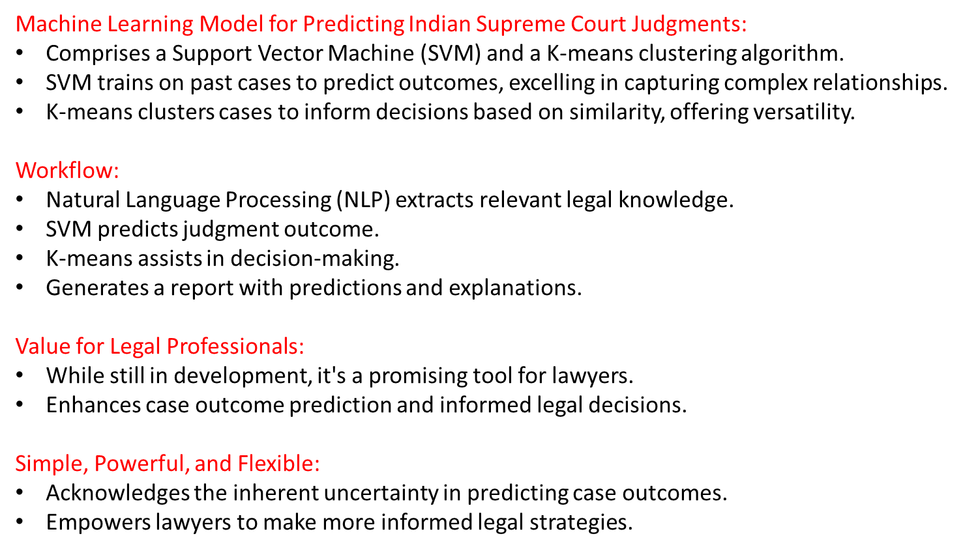
Architecture

Slide 11

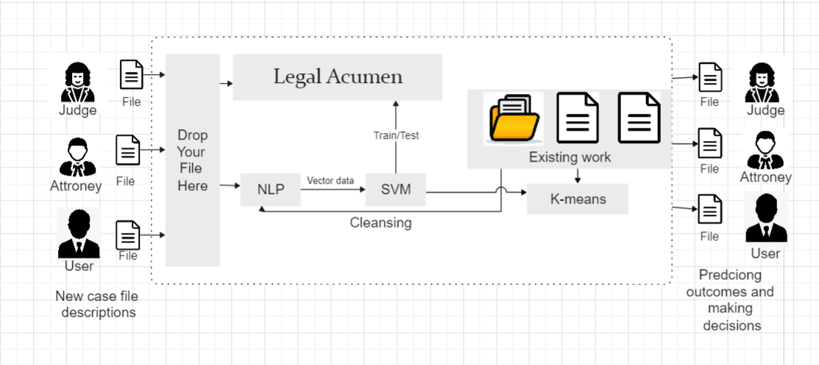

Machine Learning Model for Predicting Indian Supreme Court Judgments:
Comprises a Support Vector Machine (SVM) and a K-means clustering algorithm.
SVM trains on past cases to predict outcomes, excelling in capturing complex relationships.
K-means clusters cases to inform decisions based on similarity, offering versatility.

Slide 12
Workflow:
Natural Language Processing (NLP) extracts relevant legal knowledge.
SVM predicts judgment outcome.
K-means assists in decision-making.
Generates a report with predictions and explanations.
Value for Legal Professionals:
While still in development, it's a promising tool for lawyers.
Enhances case outcome prediction and informed legal decisions.
Simple, Powerful, and Flexible:
Acknowledges the inherent uncertainty in predicting case outcomes.
Empowers lawyers to make more informed legal strategies.

Slide 13
E
B
A
Data Preparation
C
D
Scaling and Normalization:
Scaled 'age' and 'majority_vote' attributes for homogeneity using Standard Scaler.
Ensured the dataset's effectiveness and robustness for subsequent analysis.
Data Preparation:
Transformed 'judgement' attribute into uppercase strings, retaining instances with 'TRUE' values.
Added an 'age' column based on timestamps for contextual information.
Case Documents Acquisition:
Obtained Indian Supreme Court judgments from kaggle.com, resulting in a corpus of over 3000 cases.
Refined to 1001 cleaned and finalized cases for analysis.
Categorical Encoding:
Encoded 'decision_type' using Label Encoder for machine learning compatibility.
Selected a subset of relevant entries for manageable computational complexity.
Data Cleansing:
Identified and addressed outliers and inconsistent values in 'majority_vote.'
Removed instances with missing or erroneous data for dataset reliability.

Slide 14
Data Preparation
A
B
C
D
E
Case Documents Acquisition:
Obtained Indian Supreme Court judgments from kaggle.com, resulting in a corpus of over 3000 cases.
Refined to 1001 cleaned and finalized cases for analysis.
Data Preparation:
Transformed 'judgement' attribute into uppercase strings, retaining instances with 'TRUE' values.
Added an 'age' column based on timestamps for contextual information.
Data Cleansing:
Identified and addressed outliers and inconsistent values in 'majority_vote.'
Removed instances with missing or erroneous data for dataset reliability.
Categorical Encoding:
Encoded 'decision_type' using Label Encoder for machine learning compatibility.
Selected a subset of relevant entries for manageable computational complexity.
Scaling and Normalization:
Scaled 'age' and 'majority_vote' attributes for homogeneity using Standard Scaler.
Ensured the dataset's effectiveness and robustness for subsequent analysis.

Slide 15
E
B
A
Data Preparation
C
D
Classifier Modelling
Leveraging Advanced Machine Learning Techniques: Legal Acumen relies on cutting-edge machine learning methods, including Support Vector Machine (SVM) and K-Means Clustering, to yield precise predictions from legal case documents.
Hyperparameter Tuning: The hyperparameters of SVM and K-Means have been meticulously fine-tuned to optimize their performance in the domain of legal predictions [7].
Data Split for Reliability: A rigorous 80%-20% data split has been employed, with 80% designated for training and 20% for thorough testing and validation to ensure the reliability and generalizability of the model.
Scaling and Normalization:
Scaled 'age' and 'majority_vote' attributes for homogeneity using Standard Scaler.
Ensured the dataset's effectiveness and robustness for subsequent analysis.
Data Preparation:
Transformed 'judgement' attribute into uppercase strings, retaining instances with 'TRUE' values.
Added an 'age' column based on timestamps for contextual information.
Case Documents Acquisition:
Obtained Indian Supreme Court judgments from kaggle.com, resulting in a corpus of over 3000 cases.
Refined to 1001 cleaned and finalized cases for analysis.
Categorical Encoding:
Encoded 'decision_type' using Label Encoder for machine learning compatibility.
Selected a subset of relevant entries for manageable computational complexity.
Data Cleansing:
Identified and addressed outliers and inconsistent values in 'majority_vote.'
Removed instances with missing or erroneous data for dataset reliability.

Slide 16
E
B
A
Data Preparation
C
D
Classifier Modelling
Utilizing Scikit-learn and Python: This work harmoniously combines the capabilities of Scikit-learn [13],[14], a well-established machine learning library, and Python, providing a robust programming environment that streamlines SVM and K-Means implementation.
Comprehensive Classification Report: After successfully training the SVM and K-Means classifiers [6], a comprehensive classification report is presented for each classifier, shedding light on their predictive abilities and performance characteristics.
Evaluating Model Effectiveness: These results hold significance in evaluating Legal Acumen's effectiveness, providing profound insights into its predictive accuracy and potential real-world applications.
Scaling and Normalization:
Scaled 'age' and 'majority_vote' attributes for homogeneity using Standard Scaler.
Ensured the dataset's effectiveness and robustness for subsequent analysis.
Data Preparation:
Transformed 'judgement' attribute into uppercase strings, retaining instances with 'TRUE' values.
Added an 'age' column based on timestamps for contextual information.
Case Documents Acquisition:
Obtained Indian Supreme Court judgments from kaggle.com, resulting in a corpus of over 3000 cases.
Refined to 1001 cleaned and finalized cases for analysis.
Categorical Encoding:
Encoded 'decision_type' using Label Encoder for machine learning compatibility.
Selected a subset of relevant entries for manageable computational complexity.
Data Cleansing:
Identified and addressed outliers and inconsistent values in 'majority_vote.'
Removed instances with missing or erroneous data for dataset reliability.

Slide 17
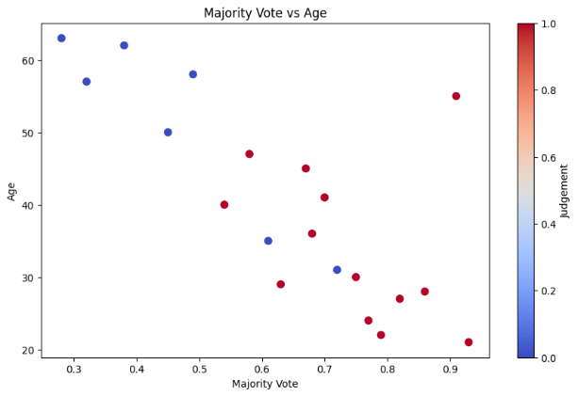
Result analysis
2. Enhanced Comprehension of Legal Documents:
Focuses on using advanced computational techniques for improved understanding of legal case documents.
2.1 Pivotal SVM Analysis:
Utilizes Support Vector Machines (SVM) to identify distinct patterns in the data.
Figure 2.1: SVM Analysis for Majority Vote vs. Age.
  Scatter plot illustrates the relationship between majority vote and age.
  Data points coloured by class labels.
  SVM classifier maximizes margin between classes, defining the decision boundary.

Slide 18
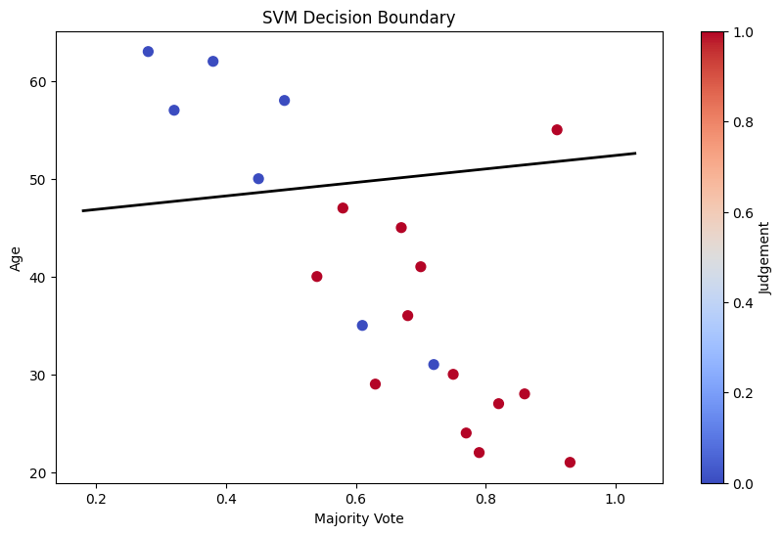
Result analysis
2.2 SVM Classifier and Hyperplane:
Demonstrates the SVM classifier's use of a hyperplane to separate classes.
Figure 2.2: SVM Hyperplane for Class Separation.
Scatter plot with data points, different colors for two classes.
The hyperplane, depicted as a straight line, acts as the decision boundary.
Determined by the SVM algorithm using provided data.
Hyperplane's slope and intercept calculated from SVM classifier's coefficients and intercept [11].
SVM positions the hyperplane to maximize the margin, effectively classifying new data points based on their side of the hyperplane.

Slide 19
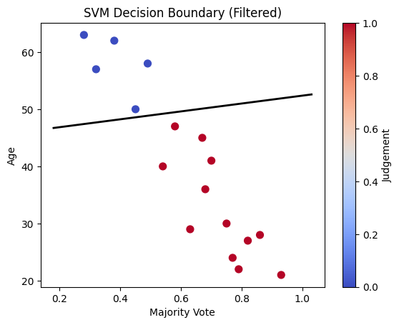
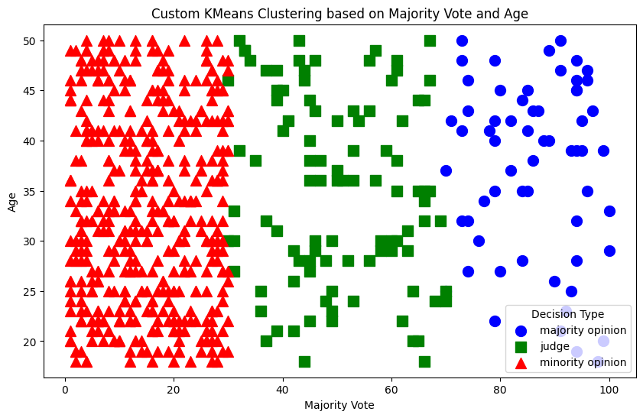
Result analysis
2.3 Data Filtering for Improved Accuracy:
Figure 2.3 illustrates data filtering for optimal results.
Scatter plot with data points, distinct colors for two classes.
Focus: Eliminating misclassified points to enhance accuracy.
SVM classifier predicts class labels for all data points, identifying misclassified points.
By excluding misclassified points, the figure showcases the improved SVM classifier's accuracy.
Filtering process optimizes the decision boundary (hyperplane) for accurate class separation

Slide 20
Result analysis
3. K-Means Clustering for Hidden Patterns:
Utilizes K-Means clustering to unveil concealed patterns in legal case data.
Process involves dataset preprocessing by filtering 'TRUE' judgments and encoding decision types.
K-Means identifies clusters based on decision types, with a scatter plot illustrating 'majority_vote' and 'age'.
3.1 Visual Representation of Clusters:
Scatter plot visually represents the clusters, revealing correlations between clusters and decision types.

Slide 21
Result analysis
3.2 Quantifying Clustering Performance:
Metrics include precision, recall, accuracy, and F1 score.
Confusion matrix vividly illustrates predicted versus actual decision type assignments.
3.3 Interpretation via "Figure 3":
Output figure, labeled as "Figure 3," encapsulates insights and enhances the understanding of the legal case data's structure and relationships.

Slide 22
Result analysis - Kmeans
4. Enhancing Legal Decision-Making:
Presented framework using machine learning for predicting judicial outcomes.
4.1 Real-Time Data Integration:
Explore extending the model to real-time data streams for live courtroom proceedings.
Enhance predictive accuracy for judges, legal practitioners, and stakeholders.
4.2 Application Across Legal Domains:
Adapt the model for various sections of law: criminal, civil, constitutional, administrative.
Facilitate tailored recommendations for legal professionals, aiding in case strategy and resource allocation.
4.3 Beyond Prediction:
Move beyond outcome prediction to identify jurisprudential trends, inconsistencies, and biases in the legal system.
Insights for judicial reforms and policy-making, promoting transparency, efficiency, and equity in the legal ecosystem.

Slide 23

Conclusion

Slide 24
Conclusion
Utilizing Machine Learning Techniques: This study harnesses machine learning, specifically Support Vector Machine (SVM) and K-Means clustering, to enhance predictive capabilities in legal decision outcomes. The research dataset encompasses crucial legal attributes, such as majority vote and the age of individuals involved in legal cases.
SVM Classifier for Decision Patterns: SVM is deployed to detect patterns in the dataset and establish a hyperplane effectively segregating two distinct classes within the 'judgment' column, achieving an accuracy of 81.3%.
K-Means Clustering for Decision Types: K-Means clustering is applied to identify inherent groupings among cases based on the encoded 'decision_type' column, visualizing distinct decision types in the majority vote-age space.
Quantitative Evaluation: The study presents quantitative evaluation results, including an accuracy of 79.8%, a recall of 76.8%, a precision of 77.2%, and an F1 Score of 75.6%, affirming the approach's effectiveness.
SVM Decision Boundary and K-Means Clustering: Figure 2.3 showcases the SVM decision boundary, while Figure 3 illustrates the K-Means clustering with precision, recall, accuracy, and F1 Score metrics, emphasizing the study's contribution to legal informatics.

Slide 25
Future avenues
Enhancing Legal Decision-Making: The study's framework contributes to improving legal decision-making through machine learning predictions.
Real-Time Data Streams: Future work includes extending the model's applicability to real-time data streams, enabling incorporation of live courtroom proceedings for more current and accurate insights.
Application in Indian Legal Landscape: The model has potential in reshaping the Indian legal landscape, offering predictions across diverse sections of law, spanning criminal, civil, constitutional, and administrative realms.
Tailored Recommendations: Implementation of the model can facilitate tailored recommendations for judges, lawyers, and litigants, aiding in case strategy, resource allocation, and efficient case management.
Identifying Jurisprudential Trends: The model's evolution allows for identifying jurisprudential trends, inconsistencies, and potential biases in the legal system, providing a basis for judicial reforms and policy-making.
Towards a Transparent Legal Ecosystem: The insights gathered aim to ensure a more transparent, efficient, and equitable legal ecosystem for the future.

Slide 26


